Slide 1
Basic Life Support
Booklet
Community sites

Slide 2
Table of Contents
DNAR
Resuscitation Equipment
Anaphylaxis
Strangulation/Ligatures
Paediatric BLS

Slide 3
DNACPR
Universal Form used in the community setting

Slide 4
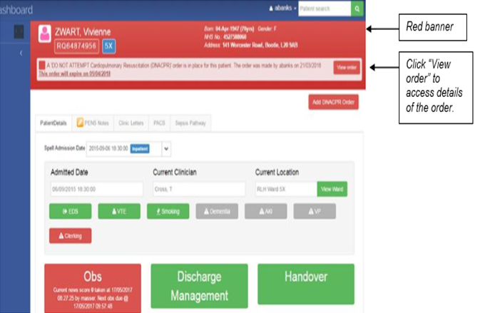
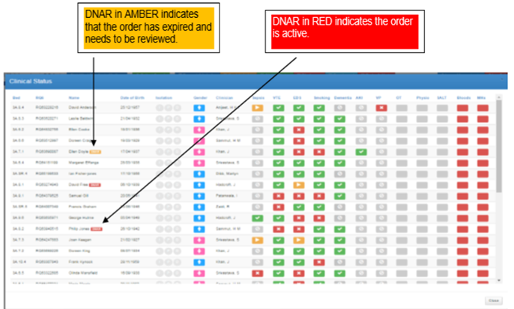
DNACPR (inpatients)
Electronic communication of DNACPR showing red banner to indicate active DNACPR with option to view order in more detail.
Below shows example of expired DNACPR in amber.

Slide 5
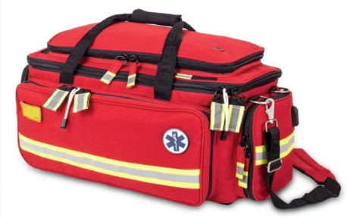
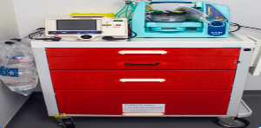
Resuscitation Equipment
Resuscitation equipment in the community varies and is dependent on the Clinical need in the department. Please familiarise yourself with the equipment within your area.
The Resuscitation equipment in your area maybe:
In a trolley In a grab bag
In a box
PLEASE ENSURE that all relevant daily and weekly checks are completed and documented on the appropriate checklists. To obtain replacement equipment for the trolley/box/bag you can contact:
clinical.education@liverpoolft.nhs.uk or Tel : 0151 529 5317

Slide 6
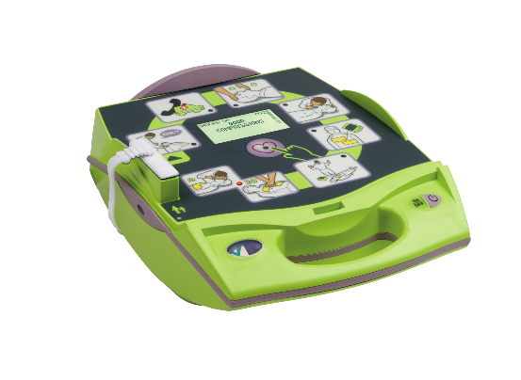
Resuscitation Equipment
As part of the Resuscitation equipment in your area you may have an AED defibrillator. Below are the 2 types of AED defibrillators we have in our trust.

Slide 7
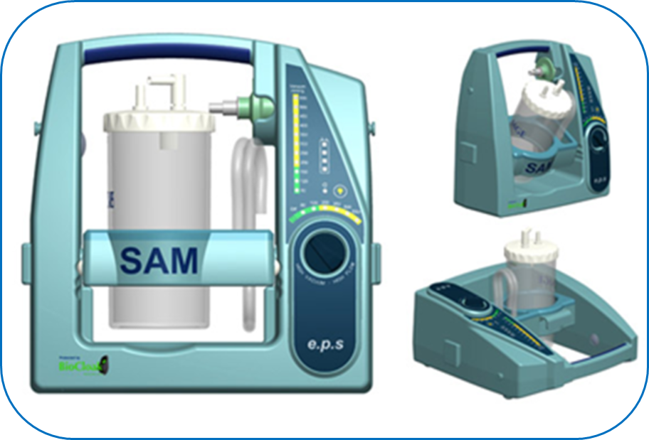
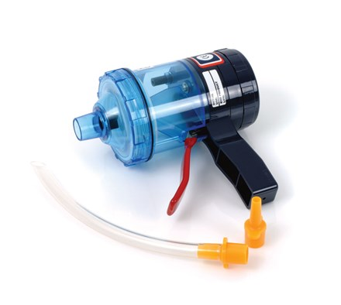
Suction Devices
As part of your resuscitation equipment you may have suction devices. Below are examples of electronic and hand held suction devices.

Slide 8
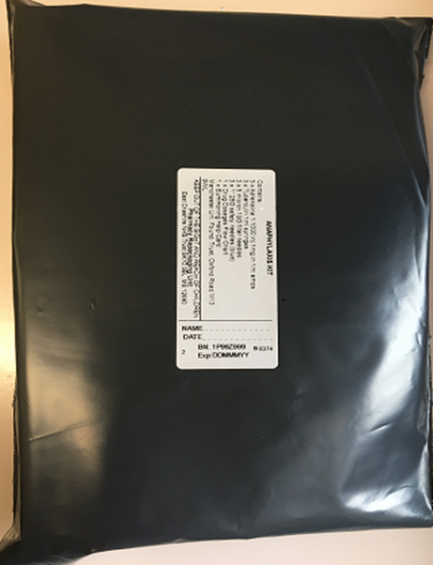
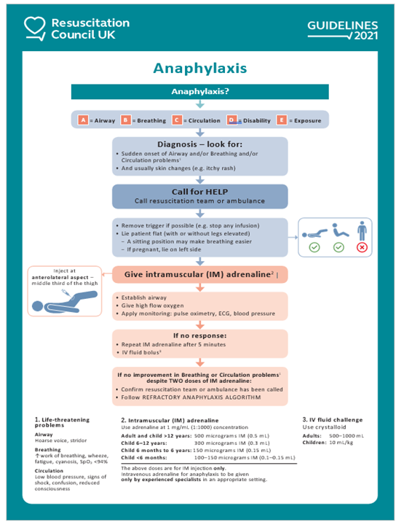
Anaphylaxis
In the event of anaphylaxis:
Call for an ambulance on 999
If available, get anaphylaxis kit located with your resuscitation equipment
Follow algorithm as per next page (also available in anaphylaxis kit)
For further information please access the LUHFT anaphylaxis training module on ESR

Slide 9
What to do on finding someone who has used a ligature
GET HELP – pull the emergency buzzer and dial 2222 (state medical emergency, confirm your location and request an anaesthetist)
REQUEST the cardiac arrest trolley
SUPPORT the persons weight (if safe to do so)
As soon as possible release the tension on the ligature
Keep the body weight supported or the tension off the ligature until cut
ALWAYS attempt resuscitation in line with trust guidance

Slide 10
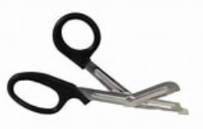
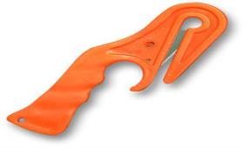
Managing Strangulation
Tuff Cut scissors can be found in all cardiac arrest trolleys acros the organisation, they are located in the airway drawer (Aintree Trolleys – 1st drawer, Royal/BGH Trolleys - 2nd drawer) and should be used for clothing, seat belts & nylon, Leather, Denim, plastic ties and ropes.
Ligature Cutters can be found in all cardiac arrest trolleys across the organisation, they are located in the airway drawer (Aintree Trolleys – 1st drawer, Royal/BGH trolleys 2nd drawer) and should be used for strapping, bubble wrap, tape, rope, some wires, shrink wrap and plastic ties.
For more information please contact: Arran Banks, Deputy Director of Patient Safety arron.banks@liverpoolft.nhs.uk

Slide 12
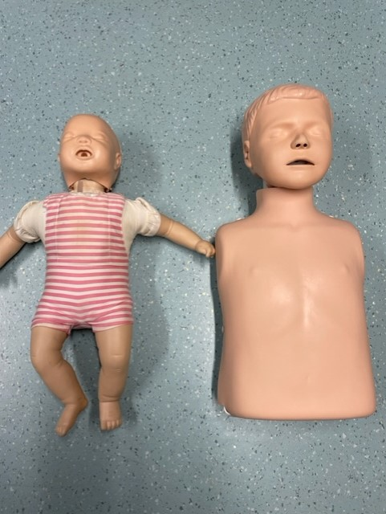
Paediatric Basic Life Support

Slide 13
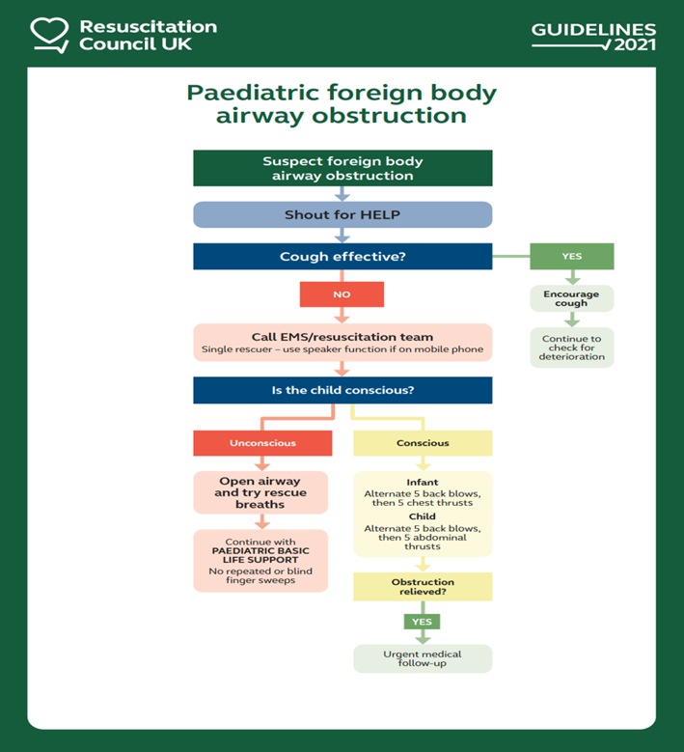
Paediatric Choking Algorithm

Slide 14
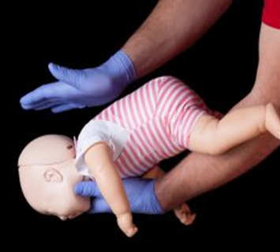
Management of Choking in an Infant (under 1 year old)
Support the infant in a head-downwards, prone position to enable gravity to assist removal of the foreign body.
A seated or kneeling rescuer should be able to support the infant safely across their lap.
Support the infant’s head by placing the thumb of one hand at the angle of the lower jaw and one or two fingers from the same hand at the same point on the other side of the jaw.
Deliver up to 5 sharp back blows with the heel of one hand in the middle of the back between the shoulder blades.
Do not use abdominal thrusts for infant.

Slide 15
Management of Choking in Children (over 1 year old)
Back Blows
Back blows are more effective if the child is positioned head down.
Deliver up to 5 sharp back blows with the heel of one hand in the middle of the back between the shoulder blades.
Abdominal Thrusts
Stand or kneel behind the child. Place your arms under the child’s arm and encircle their torso.
Clench your fist and place it between the umbilicus and xiphisternum. Grasp your fist with your other hand and pull sharply inwards and upwards. Repeat up to four more times.

Slide 16
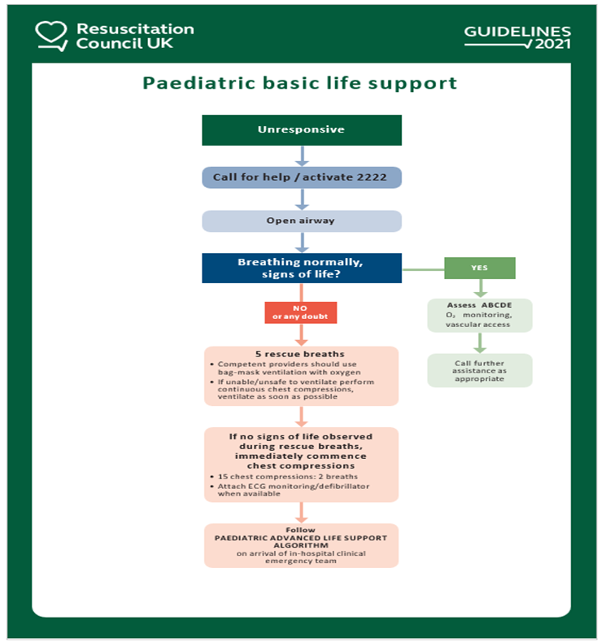
Paediatric BLS

Slide 17
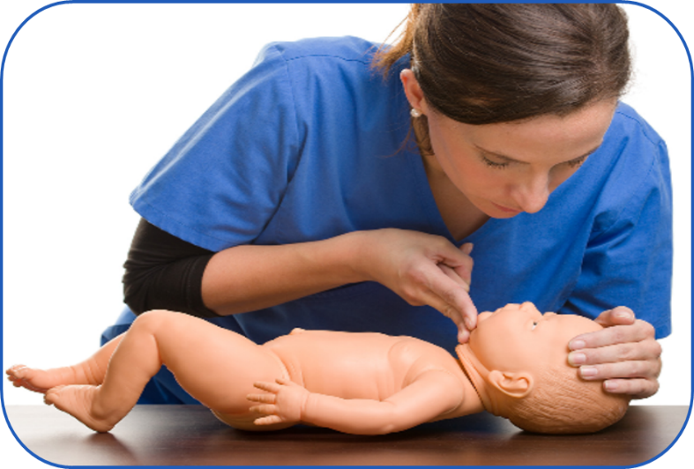
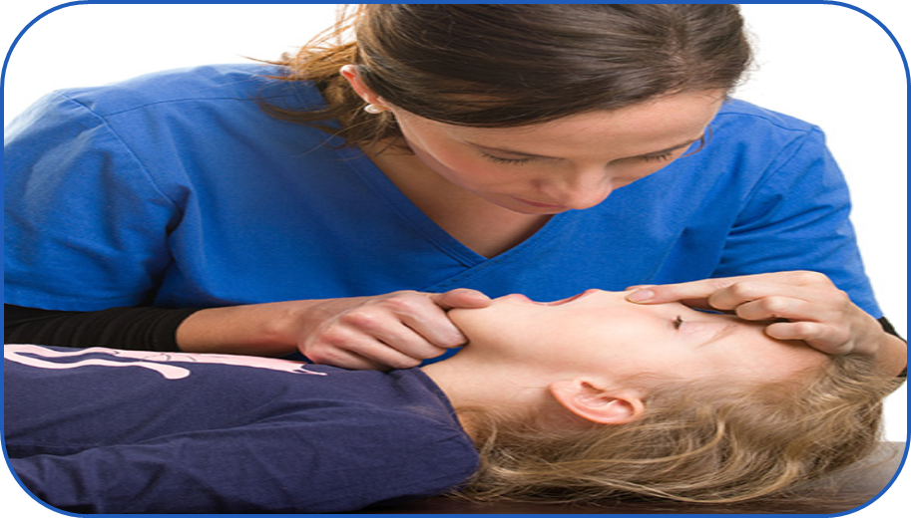
Airway Management
Keep airway position neutral for an infant under 1 year old.
In a child over 1 use sniffing position to open airway.

Slide 18
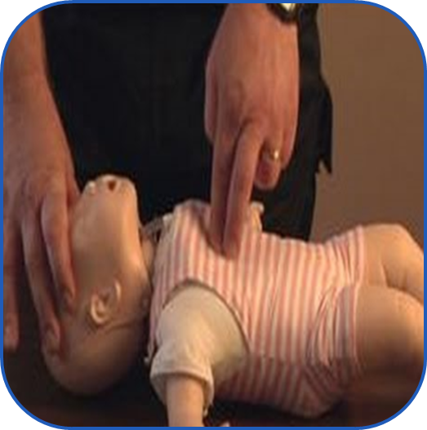
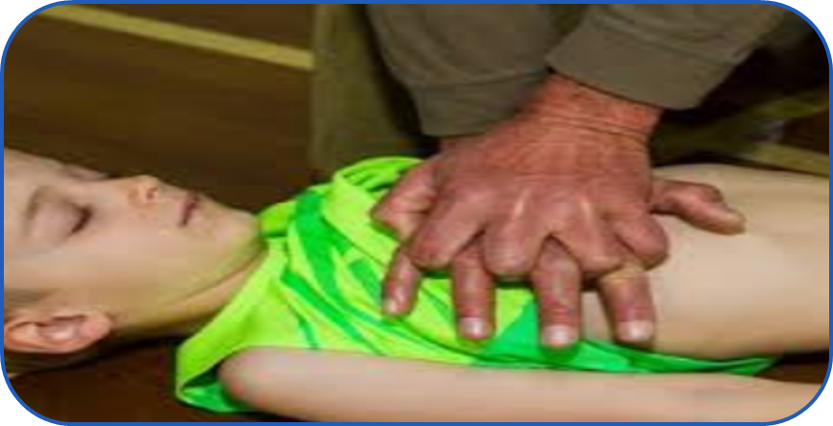
Chest Compressions
Infant - Use two fingers to deliver chest compressions.
Child over one – Use 1-2 hands to deliver chest compressions

